Slide 1
NBA Player Performance
& Salary Analytics Pipeline
CPSC 482 — Data-Intensive Systems
Jacob Jarvis | Spring 2026

Slide 2
Project Goals
End-to-End Pipeline
Build a complete data workflow on GCP from raw ingestion through analytics and visualization
Performance Analytics
Analyze 70+ years of NBA player statistics: scoring trends, career trajectories, league evolution
Salary Prediction
Train ML models to predict player salaries from stats, identifying overpaid and undervalued players
Interactive Dashboard
Deliver a Looker Studio dashboard with filterable views for exploring player and team data

Slide 3
Dataset Overview
Dataset | Records | Size | Coverage
Player Box Scores | 1,183,956 | 158 MB | 1950–2022
Player Season Stats | 25,732 | 4.5 MB | 1950–2022
Player Salaries | 15,203 | 740 KB | 1990–2023
Team Payroll | 966 | 43 KB | 1990–2023
1M+
70+
4
Game Records
Years of Data
Linked Datasets

Slide 4
Pipeline Architecture
Raw CSVs
Cloud
Storage
Dataproc
(PySpark)
BigQuery
BigQuery
ML
Looker
Studio
→
→
→
→
→
4 datasets
164 MB
GCS bucket
raw/ + processed/
Clean, dedup
compute features
4 tables
6 views
Linear Reg
XGBoost
5-page
dashboard
GCP Services Used
Cloud Storage
Dataproc (PySpark)
BigQuery + BigQuery ML
Looker Studio

Slide 5
Data Processing
1
Ingestion
Sourced 4 CSV datasets from Kaggle; uploaded raw files to GCS bucket
2
Cleaning
Parsed dates, cast numeric types, stripped currency formatting
3
Filtering
Removed zero-minute box score rows, dropped TOT aggregate rows, duplicated records
4
Feature Engineering
Computed per-36-minute stats, true shooting %, home/away flag
5
Output
Wrote 4 cleaned Parquet files; loaded into BigQuery as native tables

Slide 6
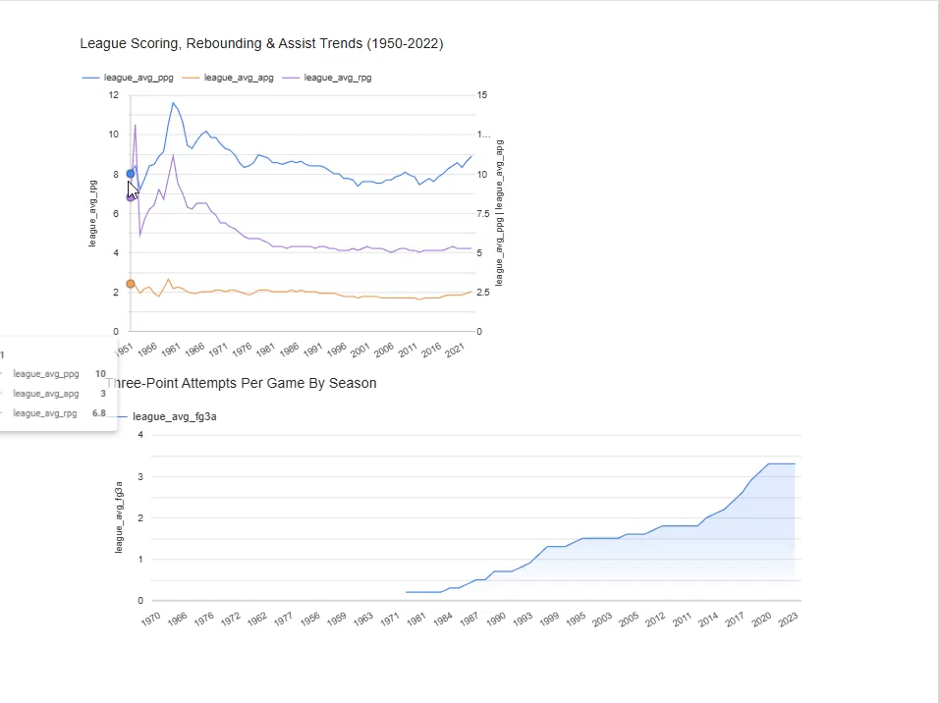
Dashboard Demo

Slide 7
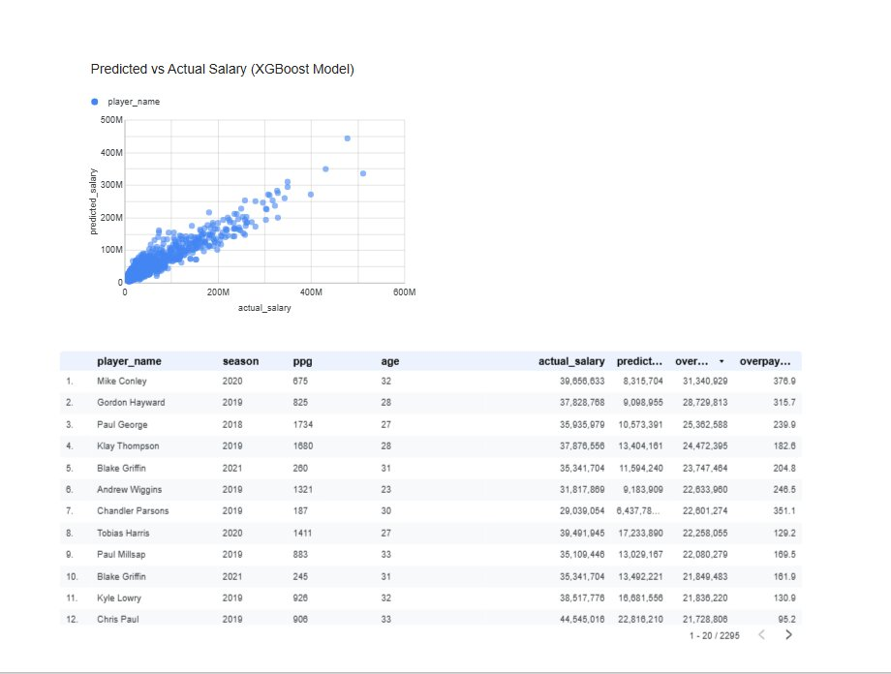
ML Model: Salary Prediction
Predict inflation-adjusted salary from player stats using BigQuery ML
Model | R² Score | MAE | Explained Variance
Linear Regression | 0.381 | $4.07M | 0.383
XGBoost | 0.484 | $3.53M | 0.487
Features: age, games played, MPG, PPG, RPG, APG, SPG, BPG, FG%, 3P%, eFG%

Slide 8
Key Insights
Three-Point Revolution
3PA per game has risen steadily from near zero in the 1970s to over 3.0 in recent seasons, reshaping offensive strategy.
Salary & Performance
The XGBoost model shows that salary does largely follow player performance trends, though some variance remains due to market dynamics, draft position, contract timing, and team cap situations that go beyond pure on-court production
Most Overpaid Players
Mike Conley (2020), Gordon Hayward (2019), and Paul George (2018) top the overpay list, with actual salaries exceeding predicted values by $25M+, often due to injuries reducing stats while salaries remained the same.
Career Efficiency Leaders
Players with high career TS% and PPG cluster tightly in the scatter plot, showing that elite scorers tend to also be efficient, volume and efficiency are not mutually exclusive.

Slide 9
Thank You
Questions?
Jacob Jarvis
CPSC 482 — Data-Intensive Systems

